Slide 1

From Human Intelligence To Machine Intelligence GU Zhan (Sam) Institute of Systems Science, NUS Zhan.Gu@nus.edu.sg
- restricted -

Slide 2
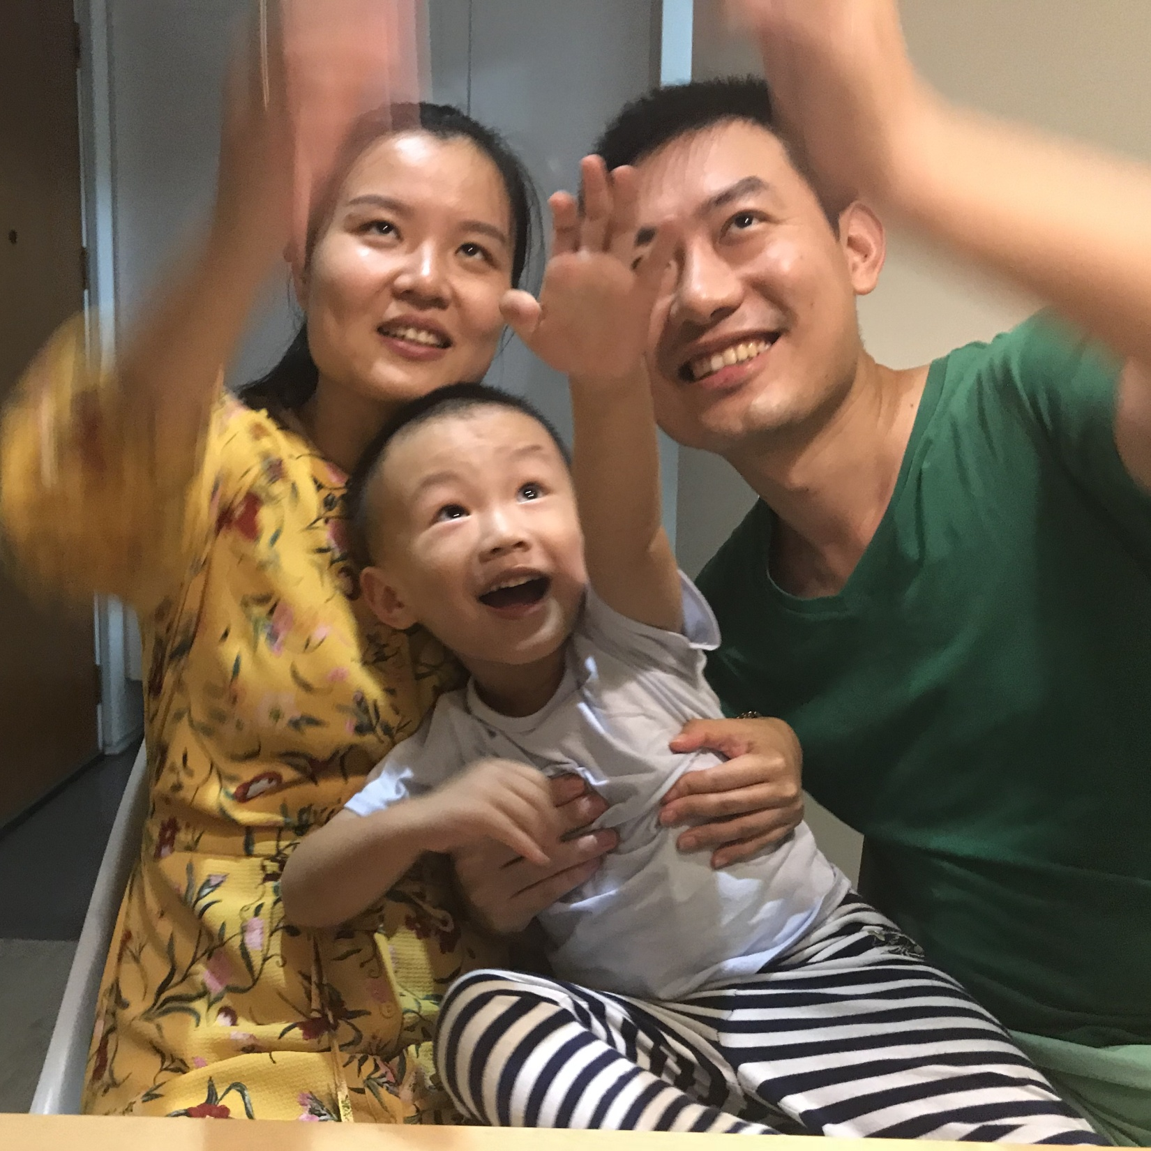
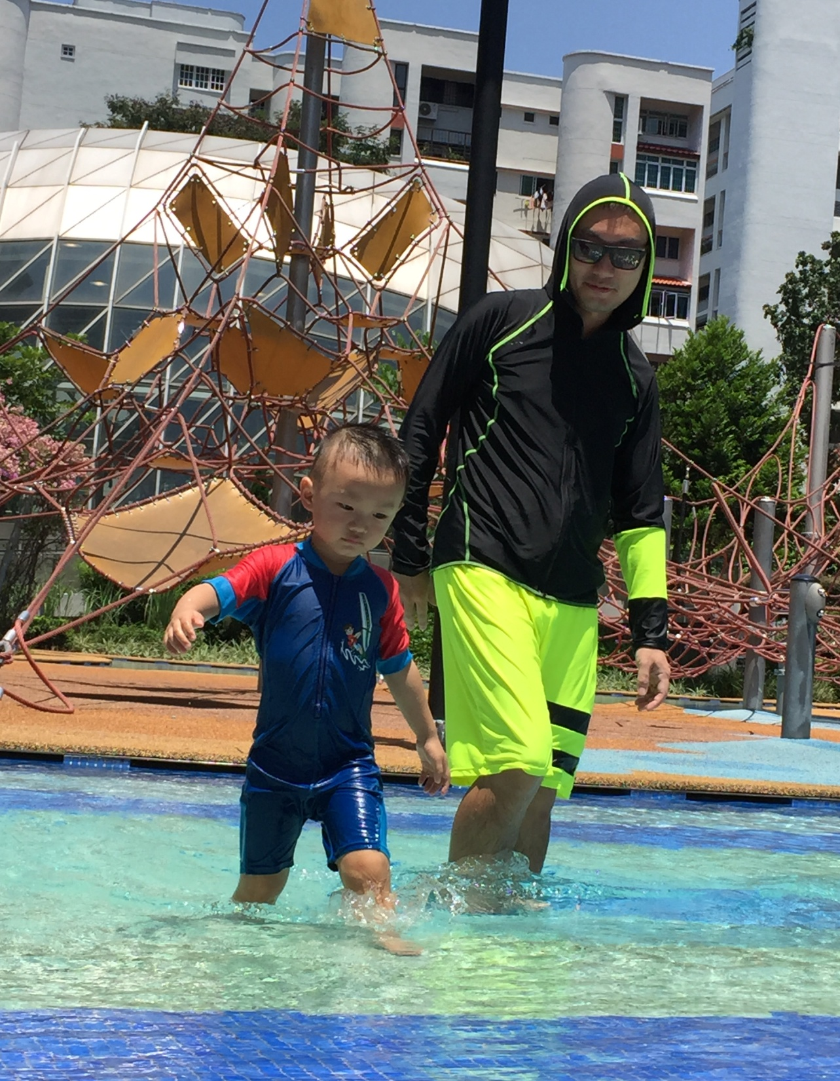

Slide 3

What is intelligence
Source https://i.warosu.org/data/biz/img/0012/12/1461543092681.jpg

Slide 4
What’s intelligence?
“Intelligence measures a human/AI’s ability to achieve goals in a wide range of environments.”
A Universal Measure of Intelligence for Artificial Agents, Legg & Hutter 2007
Examples?
Goals in school environment?
Goals in work environment?
Goals in home environment?
Notes:
https://en.wikipedia.org/wiki/Cognition

Slide 5
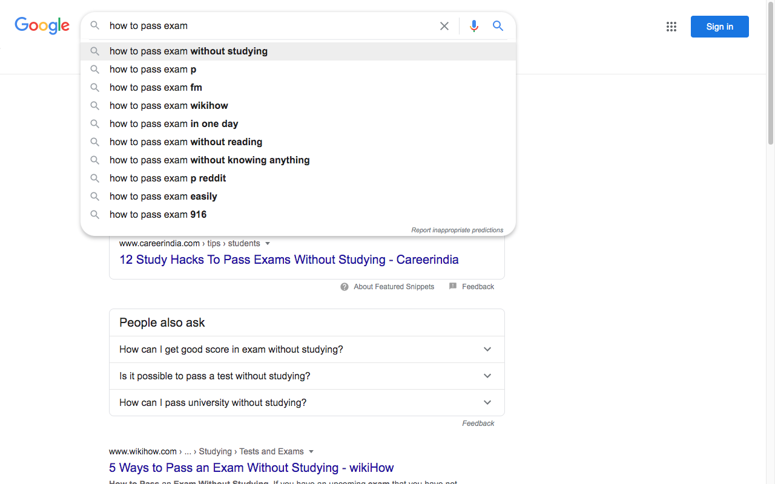
To achieve goal in school environment…
Different agents’ ability indicated by:
more/less effort spent?
higher/lower exam score?
Notes:
https://en.wikipedia.org/wiki/Cognition

Slide 6
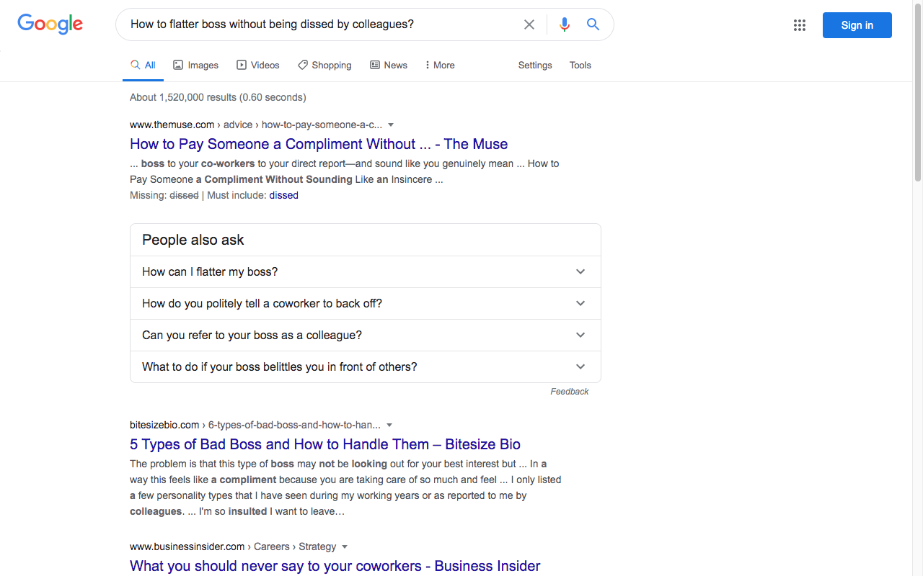
To achieve goal in work environment…
Different agents’ ability indicated by:
more/less secrecy?
bigger/smaller bonus?
A recommender system !
Notes:
https://en.wikipedia.org/wiki/Cognition

Slide 7
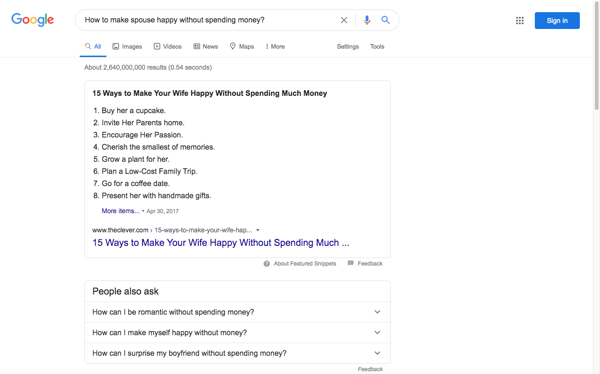
To achieve goal in home environment…
Different agents’ ability compared by:
more/less money spent?
more/less quarrels?
Notes:
https://en.wikipedia.org/wiki/Cognition

Slide 8

We all are intelligent agents in daily life...
The environment is analogical to industry domain:
E.g. Retail; Semiconductor; Finance;
The goal is analogical to perform job role:
E.g. Salesperson; Test/Quality Engineer; Ah Long (Loan shark);
The ability is analogical to KPIs (for the job role):
E.g. Larger sales volume; More test scenarios/coverage; More graffiti & interest $;
Creating an AI is analogical to defining goal & quantifying KPIs for an employee/AI to behave autonomously (through learning and reasoning using domain knowledge) without the boss/designer’s micro-management (explicitly programmed).
Notes:
https://en.wikipedia.org/wiki/Cognition

Slide 9
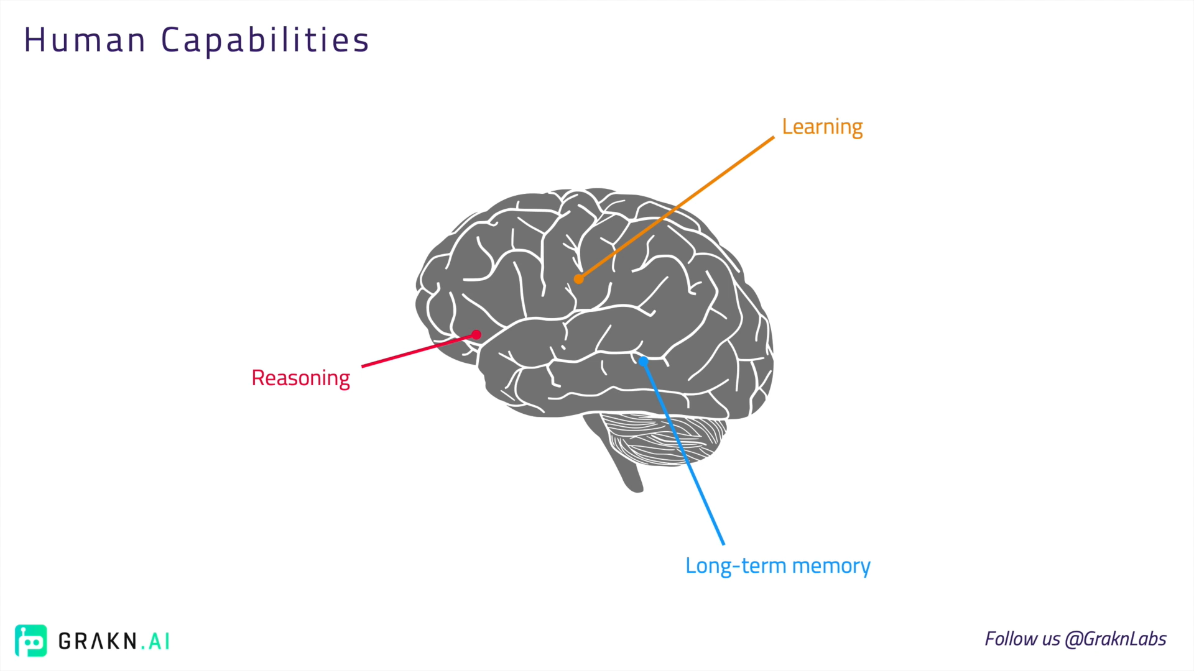
Source https://youtu.be/JlcGfwb6CDE

Slide 10
Human Memory
to store data, e.g. abstract knowledge, sensory information, experiences, etc. and this Infineon #digitization talk as well.

Slide 11
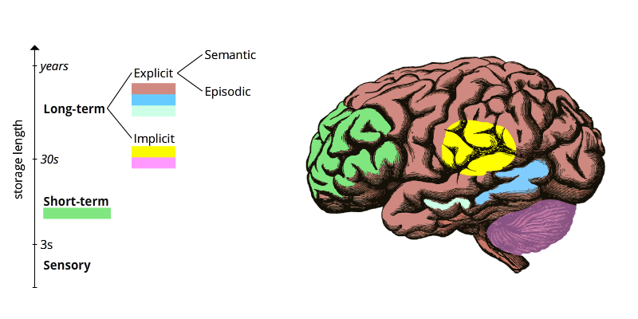
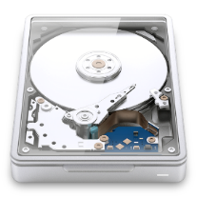
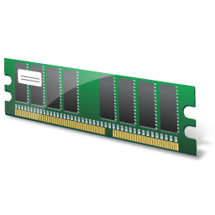
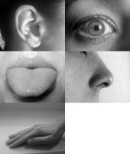

Slide 12
Human Learning
to generate new knowledge
E.g. acquired understanding, behaviours, skills, values, useful to memorize & reuse

Slide 13
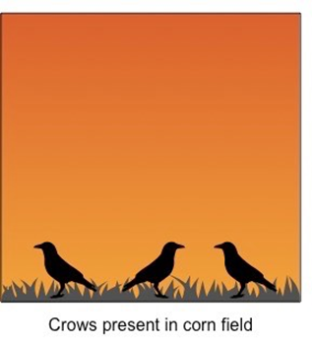
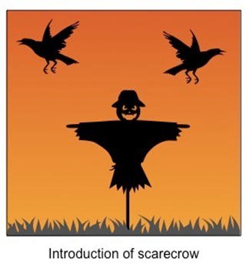
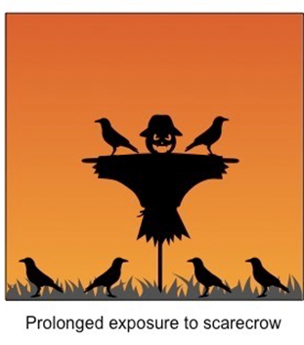
Common Forms of Learning
Habituation
Unsupervised Learning; Anomaly Detection
Bird learned the knowledge/behaviour to ignore the fake threat;
Source https://ib.bioninja.com.au/options/option-a-neurobiology-and/a4-innate-and-learned-behav/habituation.html

Slide 14
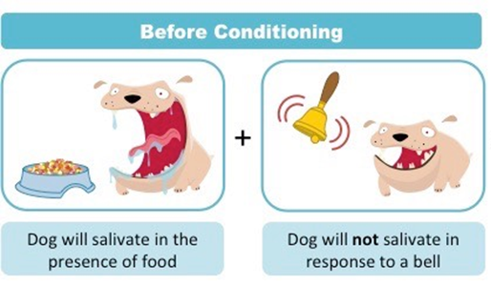
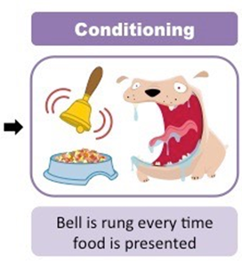
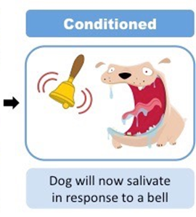
Common Forms of Learning
Classical (Reflex) conditioning
Association (between stimuli or events); Supervised Learning
Dog learned the knowledge of association/correlation: between food & bell ring;
Dog learned the knowledge/behaviour of causation: food/bell ring → saliva;
Source https://ib.bioninja.com.au/options/option-a-neurobiology-and/a4-innate-and-learned-behav/conditioning.html
Notes:
https://courses.lumenlearning.com/wsu-sandbox/chapter/classical-conditioning/

Slide 15
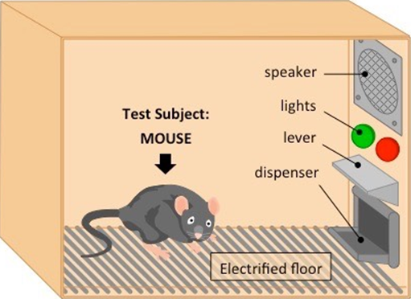
Common Forms of Learning
Operant conditioning
Reinforcement Learning; Generate & Test; Simulation
Mouse learned the knowledge of button functions & steps to obtain food;
Subject / Reinforcement Learning Agent
Agent: Mouse
Environment: Cage
Goal: Survive longer
Random Series of Actions
Best Series of Actions leading to survival & welfare
Source https://ib.bioninja.com.au/options/option-a-neurobiology-and/a4-innate-and-learned-behav/conditioning.html
Notes:
https://courses.lumenlearning.com/wsu-sandbox/chapter/operant-conditioning/

Slide 16
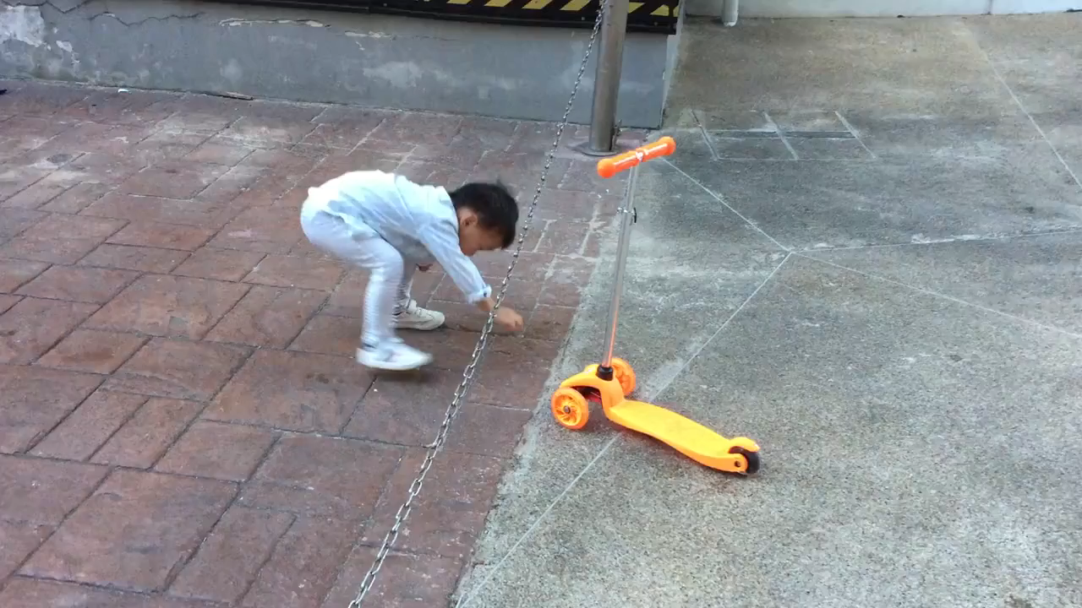
Common Forms of Learning
Operant conditioning
DiDi :
A Reinforcement Learning Agent
Agent: DiDi
Environment: NUS
Goal: Unblock/Move scooter
Random Series of Actions
Best Series of Actions leading to goal
Source https://telescopeuser.wordpress.com/2018/08/20/didi-a-reinforcement-learning-agent/
Video https://youtu.be/8K-fNcJU0nk

Slide 17
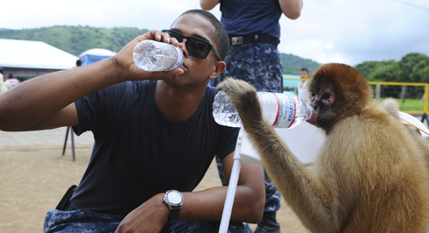
Common Forms of Learning
Observational learning
Imitation Learning; Unsupervised Learning; (copycat learning)
Source https://courses.lumenlearning.com/wsu-sandbox/chapter/observational-learning-modeling/
Notes:
https://courses.lumenlearning.com/wsu-sandbox/

Slide 18
Human Reasoning
to use existing knowledge

Slide 19
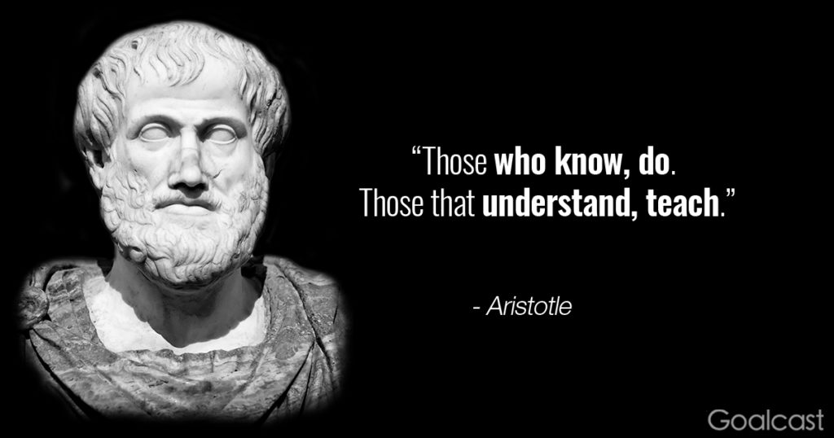
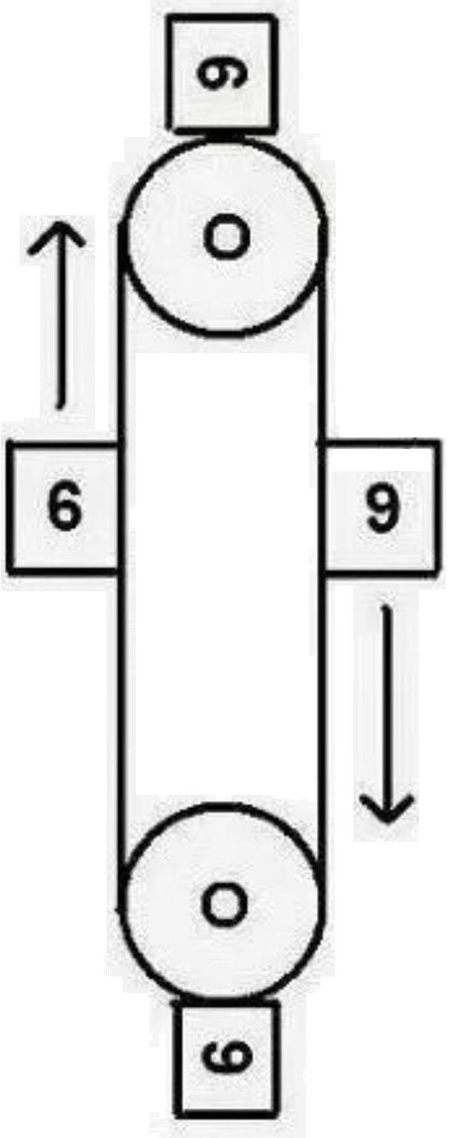
Common Forms of Reasoning
Deductive Reasoning
Aristotle's syllogism; Logic; Knowledge Graph; Decision automation; (Universal knowledge → Individual observations)
Weight in kg
Sam’s perpetual motion machine on sale! $0.99 only!

Slide 20
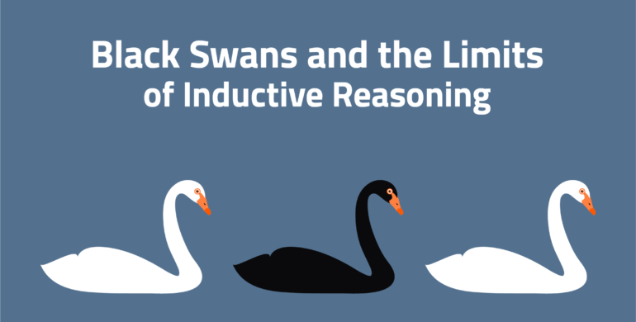
Common Forms of Reasoning
Inductive Reasoning (aka. learning)
Use meta knowledge (statistical methods) to generate new knowledge; (Individual observations/data → Universal knowledge)

Slide 21
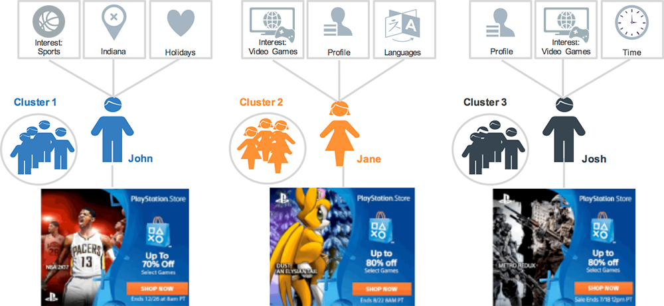

Common Forms of Reasoning
Analogical Reasoning
Similarity based reasoning; (including customer profiling for recommendation; even stereotyping)

Slide 22

Common Forms of Reasoning
Abductive Reasoning
Probabilistic calculation; Prior/Conditional/Joint probability; Bayesian network; (Hypothesis ~ Evidence)
Would you prefer to see a reasoning doctor or a learning doctor during your medical consultation?

Slide 23
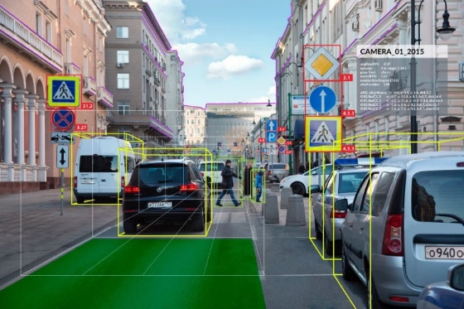
Machine / Artificial Intelligence
Major Sub-fields
Artificial Neural Networks
Evolutionary Computation
Vision
Robotics

Slide 24
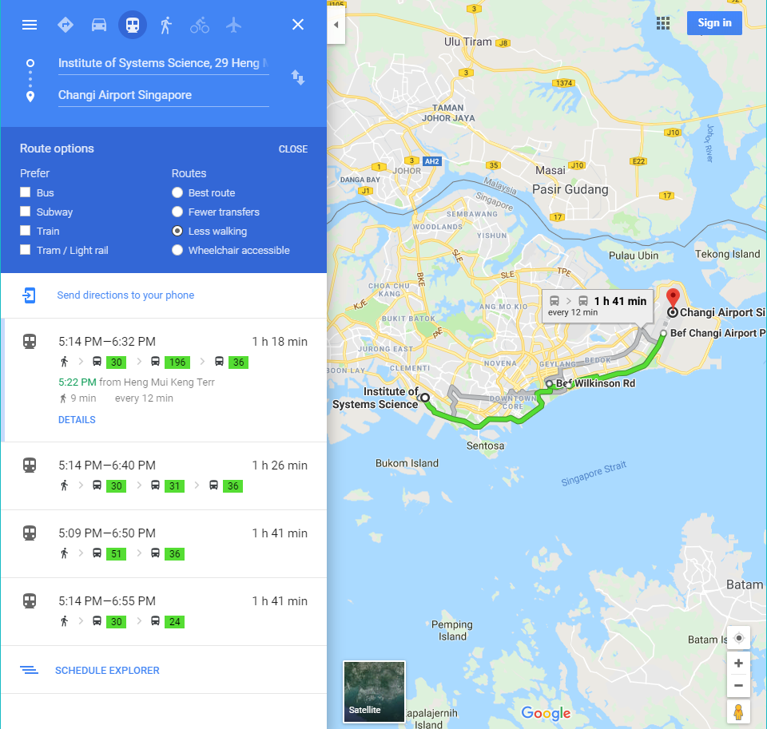
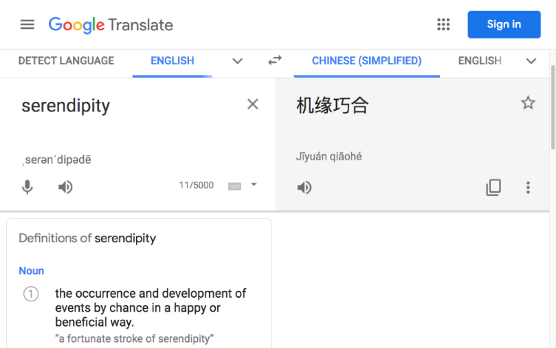
Machine / Artificial Intelligence
Major Sub-fields
Expert/Diagnostic Systems; Recommender
Speech Processing
Natural Language Processing
Planning/Optimization

Slide 25




How can I use AI to solve my business problem?
Start
Define & Quantify the business problem/opportunity {Goal, KPI}, e.g. {Increase product quality, Less defects}; {Get rich fast, More $ Less time}
Is Leaning Task:
Acquire new knowledge to solve the problem.
Is a special learning task: Reinforcement Learning Task:
Use generate & test approach.
Anyone (on Earth) knows how to solve? Or known existing/manual approaches?
False
Has relevant data collection?
False
Can simulate /generate relevant data? Or conduct experiment?
False
True
True
True
Is Reasoning/Inference Task:
Use existing knowledge to solve problem at scale and speed. (decision automation; optimization)
Use supervised: classification & regression; pattern recognition: clustering; statistical algorithms to acquire knowledge from data.
Use reinforcement learning algorithms; simulation techniques to acquire knowledge, e.g. best series of actions to achieve goal.
Currently not solvable by AI (even human)
End
Notes:
https://www.iss.nus.edu.sg/stackable-certificate-programmes/Intelligent-systems

Slide 26
Where can you apply AI?
Start by: Define & Quantify your business problem/opportunity {Goal; KPIs}.

Slide 27
An Infineon case for brainstorming

Slide 28


Slide 29
Define & Quantify {Goal, KPI}
Goal: Increased customer satisfaction with Infineon’s Cypress software: SOFTUNE Workbench
KPI: Reduced average time for Infineon to provide solutions/fixes for customer when facing problem/bugs with the software

Slide 30
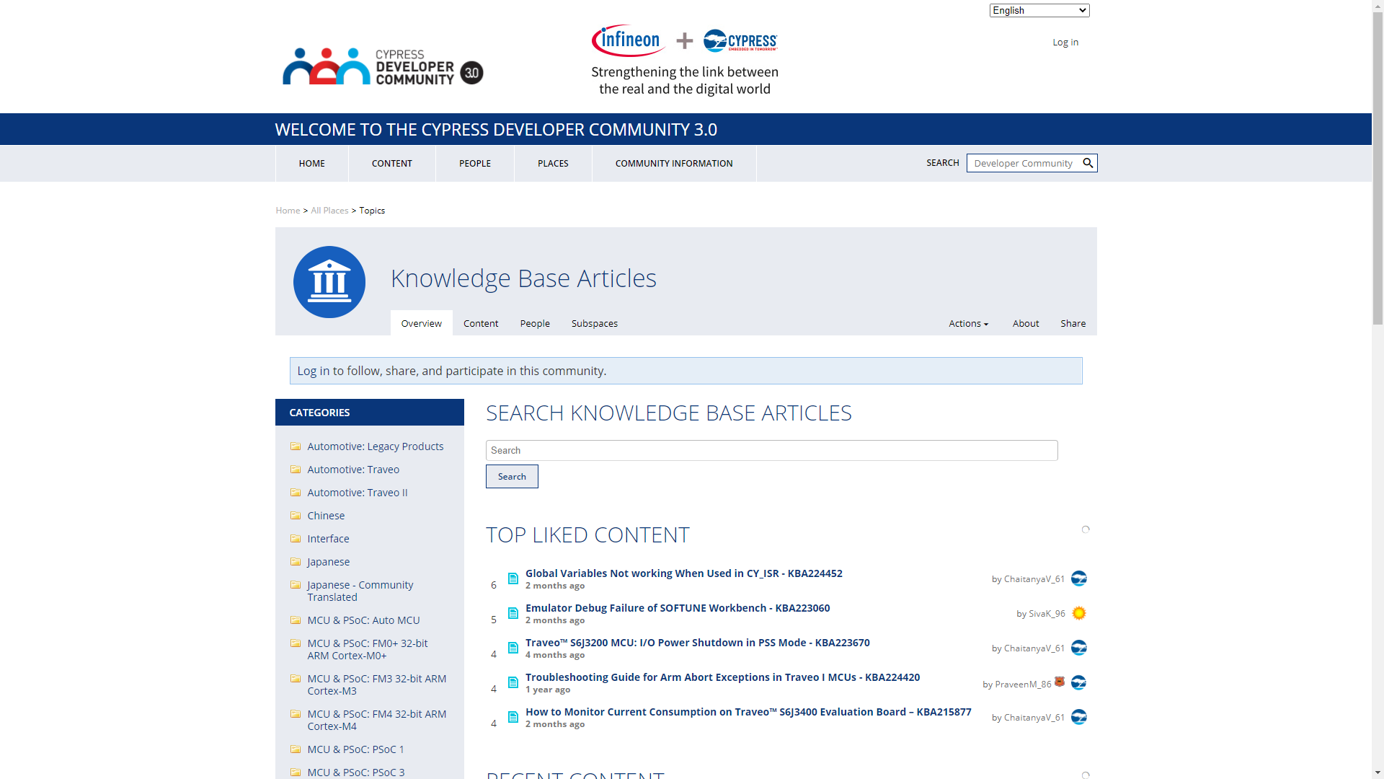

Slide 31
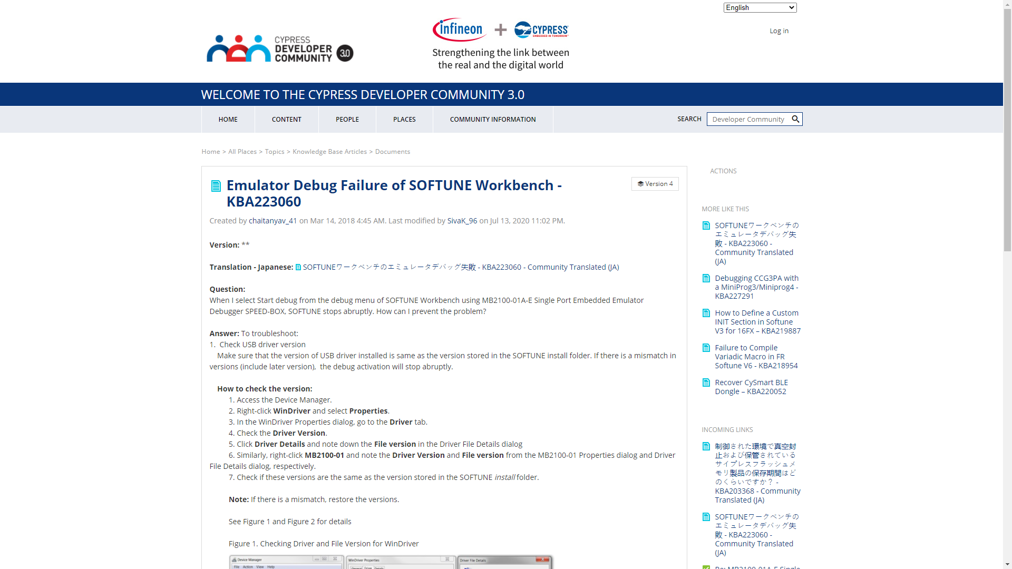

Slide 32
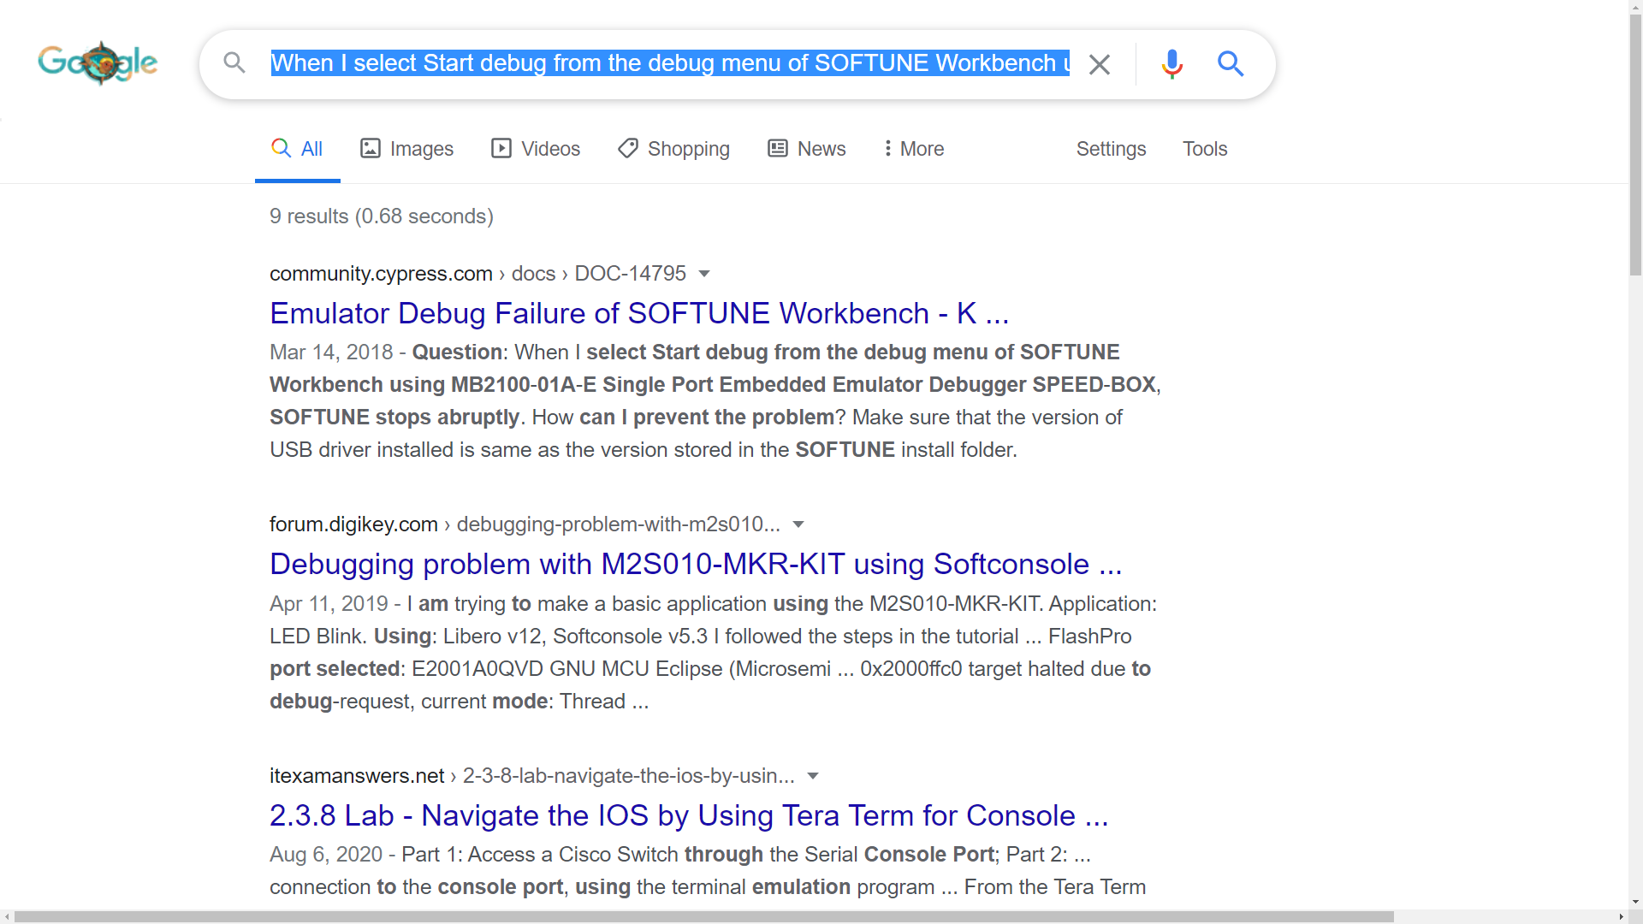

Slide 33
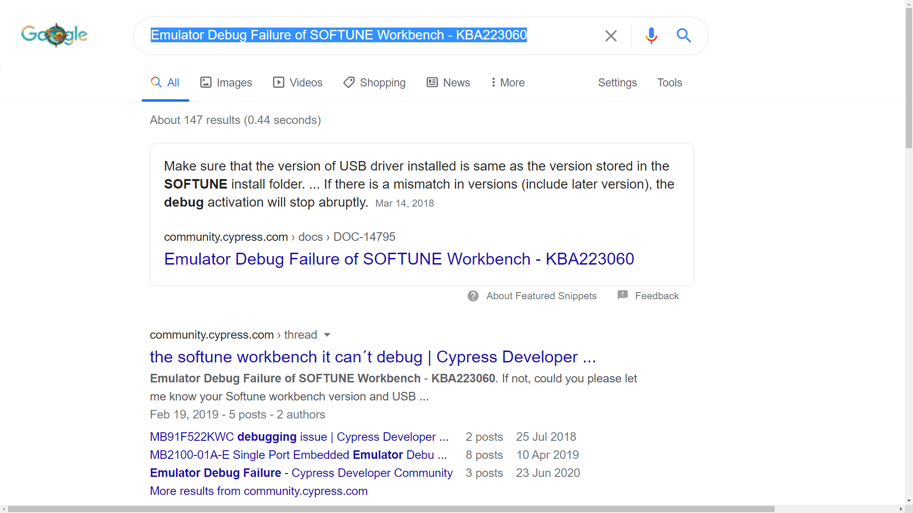

Slide 34
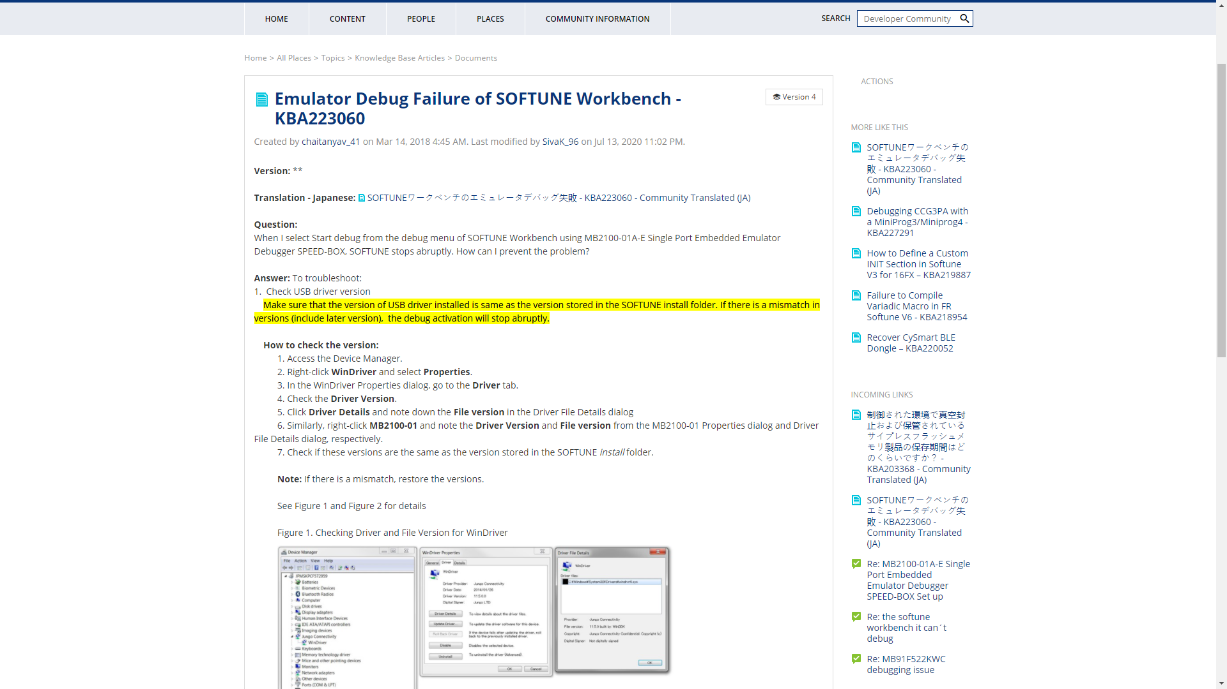

Slide 35
AI Ideations?
A smarter SOFTUNE software? Capable of embedded self diagnosis, and self health awareness via real-time error log analysis, solution retrieval (internet/cloud enabled), even self correction?
An interactive conversational knowledge-bot for faster FAQs or Q&A? (speech recognition/synthesis & information retrieval by fuzzy matching)

Slide 36
What’s your idea?

Slide 39
Appendices From Human Intelligence To Machine Intelligence

Slide 40
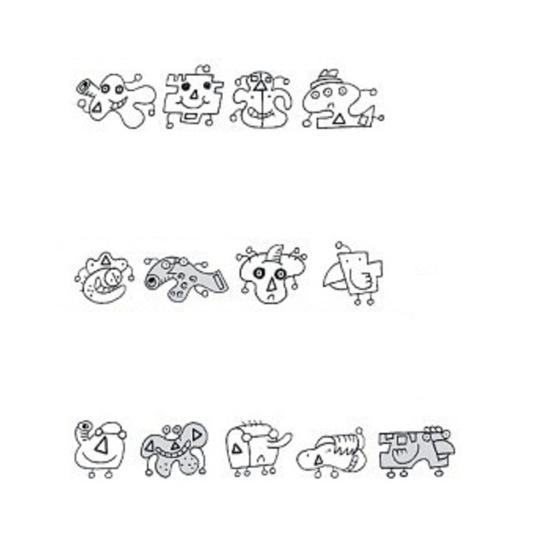
Cognitive Processes To Solve Problem
Perceive: Gather raw observable information, e.g. problem goal, type of known creatures, test creatures, decision/action required.
Recognise: Recognise patterns and decomposed relevant information, e.g. different colours, triangle#, teeth#, and any more you can recognise?
Learn: Invent hypothesis / candidate theories, e.g. hypothesis 1: alien must has eyes >=2 & not in grey & no horn. (From 8 individual creatures, their recognised features & target types to generalize/create new rules, which must be correct for the 8 creatures’ types, using supervised learning method.)
Reason: Use test data to evaluate all hypotheses / candidate theories to obtain correct knowledge. (Use A-E test creatures to filter out correct knowledge/rules which can classify 5 creatures into 1 alien 4 non-aliens. As well as the single predicated alien based on newly learnt knowledge considered correct.)
Act: Make choice, observe/bear consequences (scores).
Aliens
Non Aliens
Which one is alien?
A B C D E

Slide 41
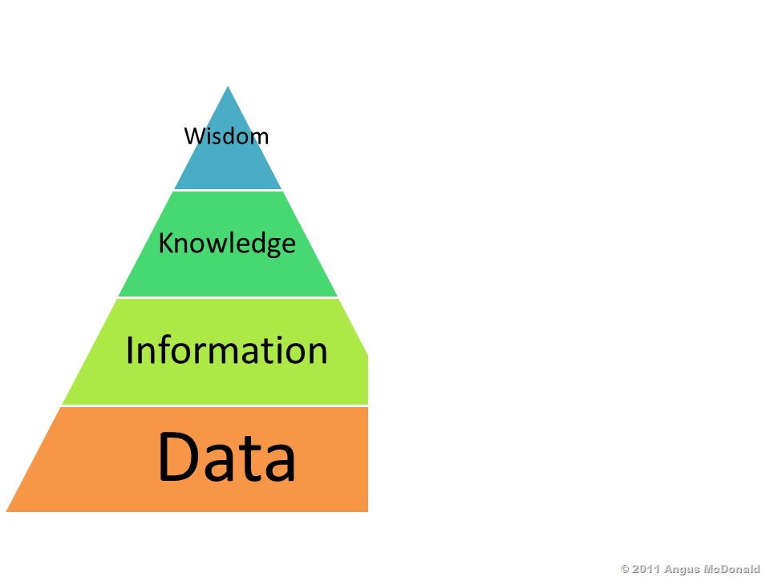
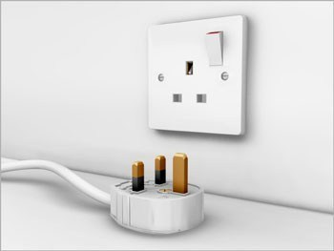
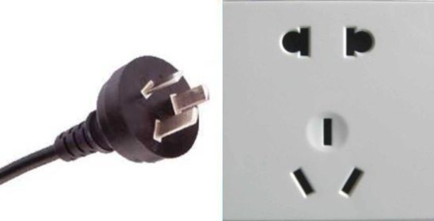

Cognitive Processes/Functions/Models
Act: Avoid touching !
Model:
Act
Logic based reasoning
(Use/Apply knowledge
in new/SG scenario)
[ Solutions ]
Model:
Reason/Think
Rule based learning:
Mom told me
never to touch !
[ Representations ]
Model:
Learn
Similarity
based
recognition
[ Patterns & Exp ]
[ Sensors ]
Model:
Recognize
Model:
Perceive
[ Percepts ]

Slide 42
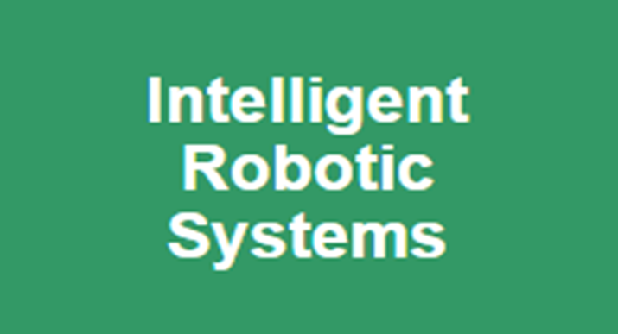
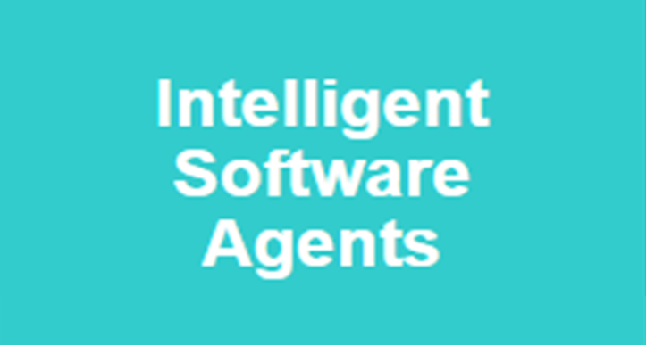

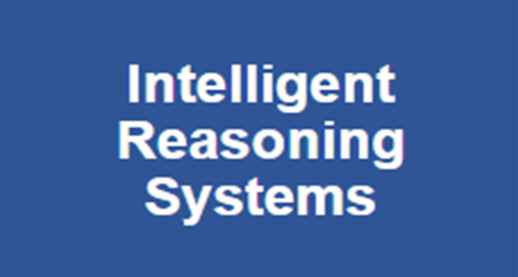

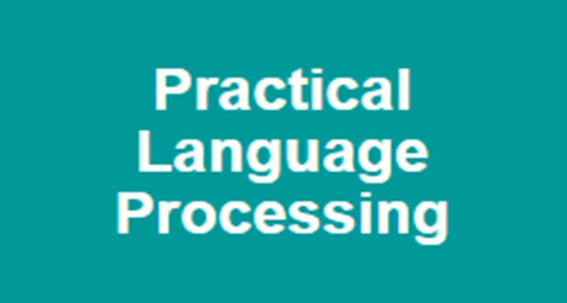
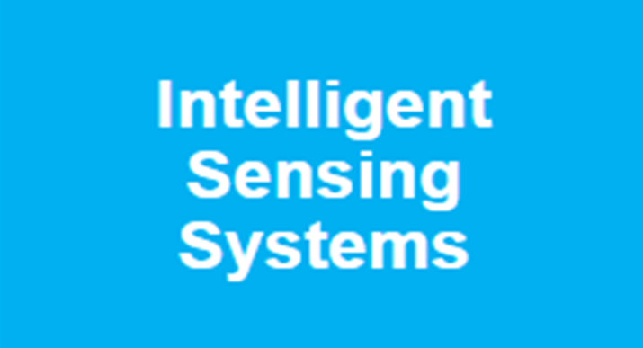
Cognitive Processes/Functions/Models
Model:
Act
Model:
Reason/Think
[ Solutions ]
Model:
Learn
[ Representations ]
[ Patterns & Exp ]
[ Sensors ]
Model:
Recognize
Model:
Perceive
[ Percepts ]

Slide 43
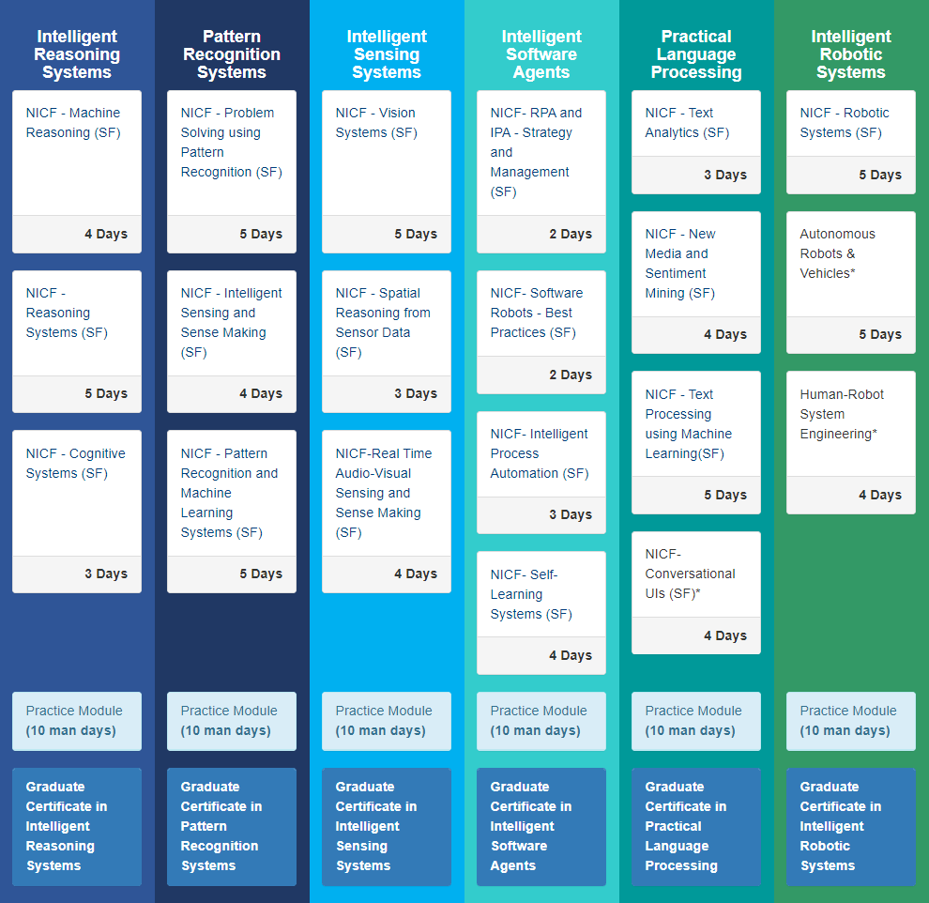

4 Certificates Courses
Flexible pathways to NUS master degree in Intelligent Systems (AI) :
Stackable (up to 7 years)
Thru-Train (full-timer 1 or part-timer 2 years)
Capstone Project
MTech Degree

Slide 44
From Human Learning
To Machine Learning
Model:
Recognize
Model:
Learn

Slide 45
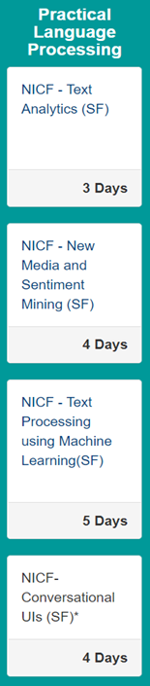
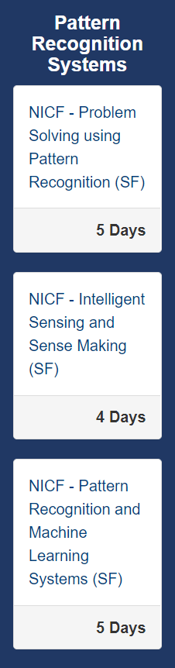
Human Learning → Machine Learning
Practical Language Processing
Text Analytics (3 days)
New Media and Sentiment Mining (4 days)
Text Processing using Machine Learning (5 days)
Conversational User Interfaces (4 days)
Pattern Recognition Systems
Problem Solving using Pattern Recognition (5 days)
Intelligent Sensing and Sense Making (4 days)
Pattern Recognition and Machine Learning Systems (5 days)
Source https://www.iss.nus.edu.sg/stackable-certificate-programmes/Intelligent-systems
Notes:
https://www.iss.nus.edu.sg/stackable-certificate-programmes/Intelligent-systems

Slide 46
From Human Reasoning
To Machine Reasoning
Model:
Reason/Think

Slide 47
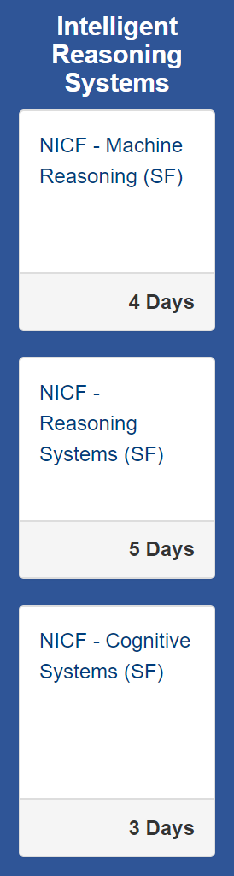
Human Reasoning → Machine Reasoning
Intelligent Reasoning Systems
Machine Reasoning (4 days)
Reasoning Systems (5 days)
Cognitive Systems (3 days)
Source https://www.iss.nus.edu.sg/stackable-certificate-programmes/Intelligent-systems
Notes:
https://www.iss.nus.edu.sg/stackable-certificate-programmes/Intelligent-systems

Slide 48
From Human Perception
To Machine Perception
Model:
Perceive

Slide 49
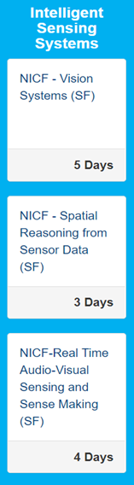
Human Perception → Machine Perception
Intelligent Sensing Systems
Vision Systems (5 days)
Spatial Reasoning from Sensor Data (3 days)
Real Time Audio-Visual Sensing & Sense Making (4 days)
Source https://www.iss.nus.edu.sg/stackable-certificate-programmes/Intelligent-systems
Notes:
https://www.iss.nus.edu.sg/stackable-certificate-programmes/Intelligent-systems

Slide 50
From Human Action
To Machine Action
Model:
Act

Slide 51
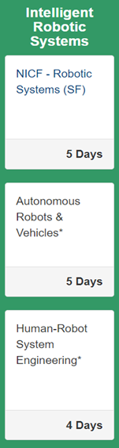
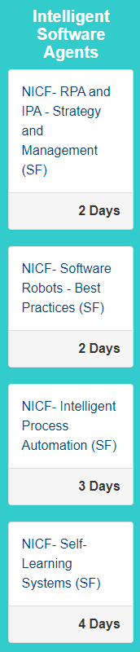
Human Action → Machine Action
Intelligent Robotic Systems
Robotic Systems (5 days)
Autonomous Robots & Vehicles (5 days)
Human-Robot System Engineering (4 days)
Intelligent Software Agents
Intelligent Process Automation (3 days)
Software Robots - Best Practices (2 days)
RPA and IPA - Strategy and Management (2 days)
Self-Learning Systems (4 days)
Source https://www.iss.nus.edu.sg/stackable-certificate-programmes/Intelligent-systems
Notes:
https://www.iss.nus.edu.sg/stackable-certificate-programmes/Intelligent-systems

Slide 52
What’s a “model”?

Slide 53
Model:
Act
What’s a “model”?
Model:
Reason/Think
[ Solutions ]
Model:
Learn
[ Representations ]
[ Patterns & Exp ]
[ Sensors ]
Model:
Recognize
Model:
Perceive
[ Percepts ]

Slide 54
What’s a conceptual model?
A model is a piece of organized & represented knowledge (our understanding of the world/domain), which can be (re)used to generate/predict outcome results based on input observations. Technically, it’s a function (white or black box), which maps input(s) to output(s)
Input(s)
XX Model
Output(s)

Slide 55
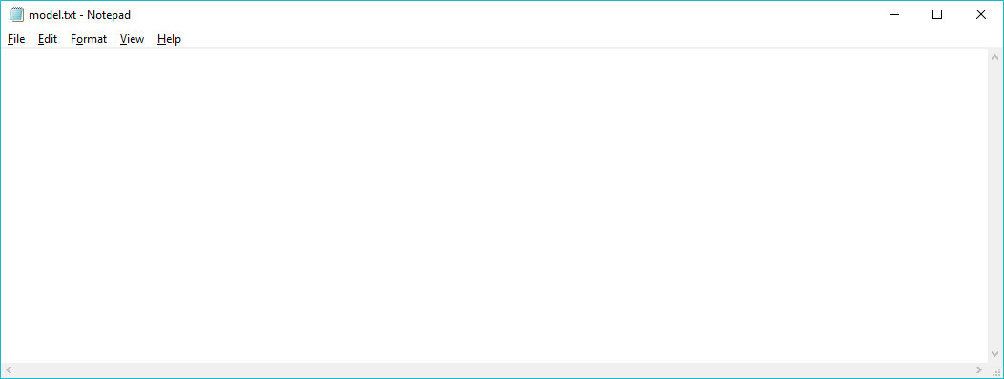
What’s a physical model?
A model could be considered just as a tangible text file stored in computer/server, e.g. model.txt
Output : Salary
Input 1 : Year-of-Education
Input 2 : Year-of-Working
Formula : Output = a x Input 1 + b x Input 2 + c
(Salary) (Year-of-Education) (Year-of-Working)
Formula parameters/coefficients : a = 520
Formula parameters/coefficients : b = 798
Formula parameters/coefficients : c = -5007

Slide 56
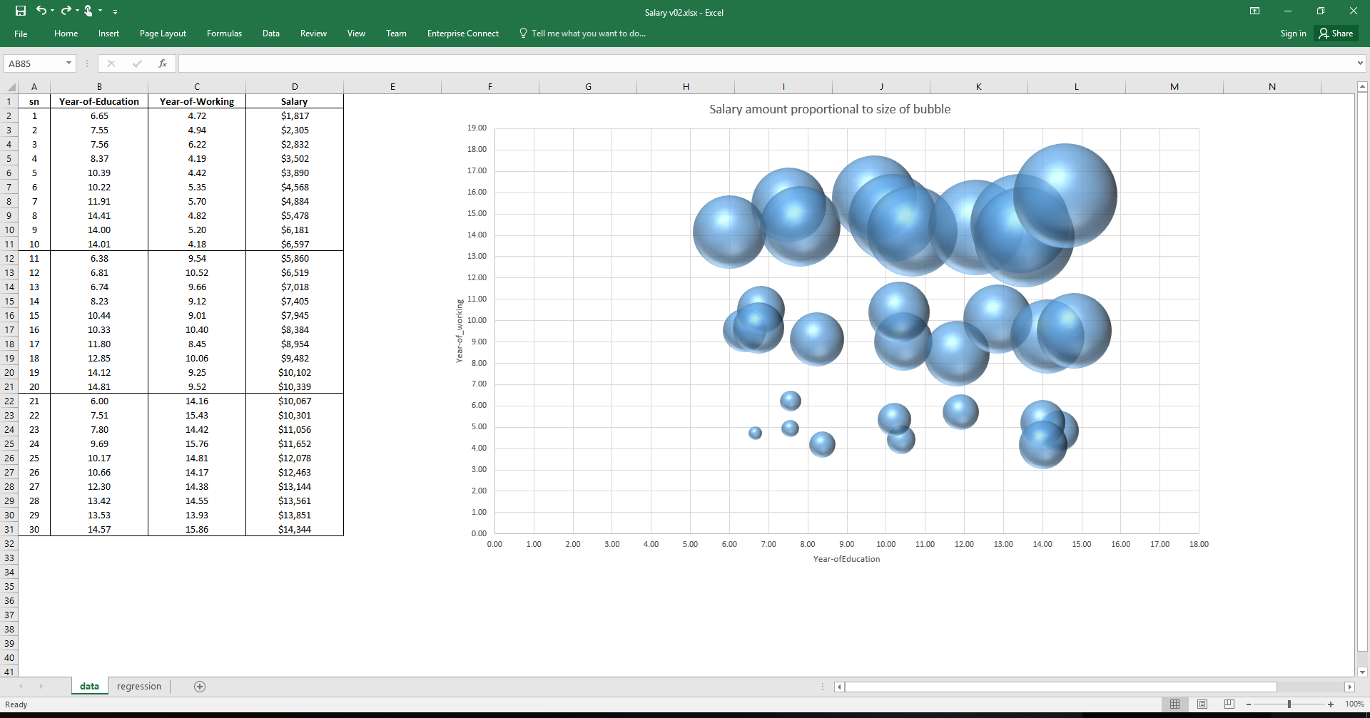

Slide 57
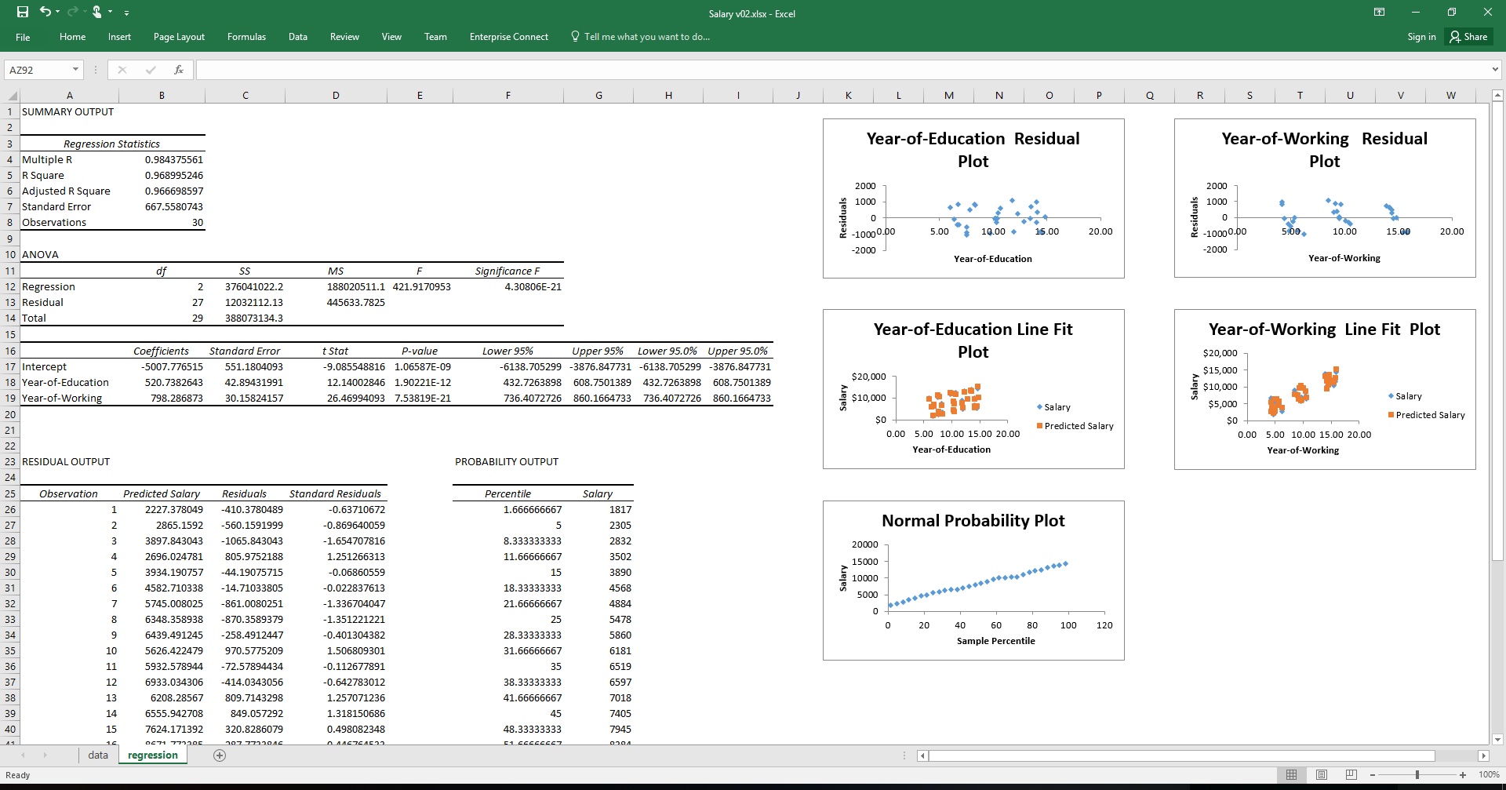

Slide 58
What are differences between models?
Different (learning/reasoning) model (applied mathematical algorithm, which is capable of min/max an objective function’s value/KPIs, e.g. Regression; Neural network; Decision tree, etc. ) extracts, organizes and represents knowledge in different ways/forms, e.g. different math formula and coefficients.
Observations
Input(s)
XX Model
e.g. Regression; Rule based system; Neural network; Decision tree; etc.
Output(s)
Conclusions

